Slide 1
Connectivity
Jorge A. Cobb
The University of Texas at Dallas

Slide 2
Paths in graphs
A path of length n in an undirected graph is a sequence of n edges such that successive edges share a common endpoint.
In a directed graph, each edge in the path (except the first) has as initial vertex the terminal vertex of the previous edge in the path.
In a simple graph (i.e., each pair of nodes can have at most one edge between them), a path is a sequence of (pairwise) adjacent vertices.

Slide 3
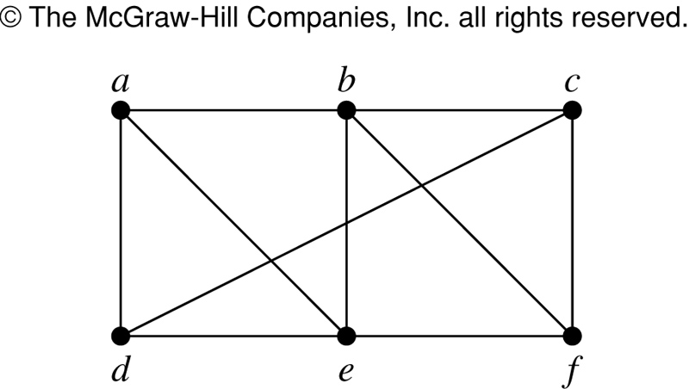
Path examples in a simple undirected graph
a,b,c
  Written differently:
    (a,b), (b,c)
a,d,e,f
a,b,c,d,a,e,b,f
d,c,f
d,c,f,e,d

Slide 4
The centroid of a graph
We define the centroid of a graph as the vertex which minimizes the sum of the lengths of the shortest paths to every other vertex
Centroid of this graph?

Slide 5
Circuits and simple paths
A path is a circuit if it starts and ends in the same vertex and has length greater than zero.
A path (or circuit) is simple if no edge appears more than once in it.
Theorem: If there is a path from a to b, there exists a simple path from a to b.

Slide 6
Circuit examples
a,b,c,d,a simple (no edge repeated)
a, b, c, d, a, b, c, d, a non-simple (edges (a,b) and (d,a) repeated)
Path from a to f:
  a, b, c, d, a, b, c, d, a, b, c, f
Simple path from a to f
  a, b, c, f

Slide 7
Connectivity
An undirected graph is connected if there is a path between any two vertices in the graph.
A directed graph
  it is strongly connected if there is a path from a to b for every a and b.
  is weakly connected if there is a path from a to b in the underlying undirected graph for every pair of vertices (a, b);

Slide 8
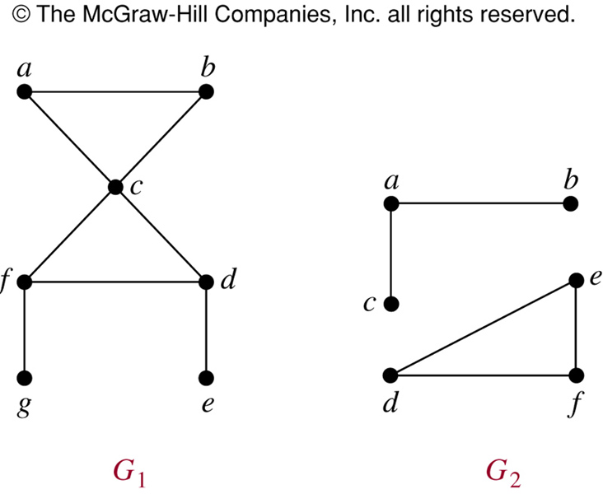
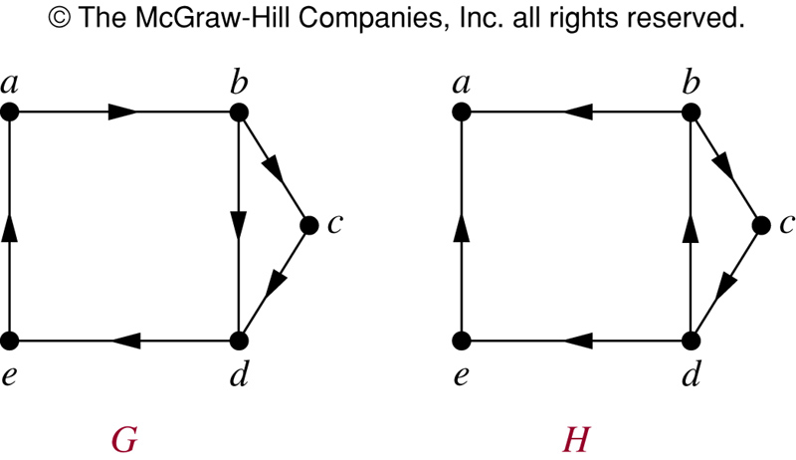
Are G and H strongly
and weakly connected?

Slide 9
Articulation points
An articulation point (or cut vertex) of a connected graph is a vertex whose removal causes the graph to not be connected anymore.
Similarly, we have bridges (or cut edges): edges whose removal make the graph not connected.

Slide 10
Connected components
A connected component of an undirected graph is a maximal subgraph that is connected (maximal in the sense that it is not a proper subgraph of another connected component).
Similarly, we get weakly and strongly connected components of directed graphs.

Slide 11
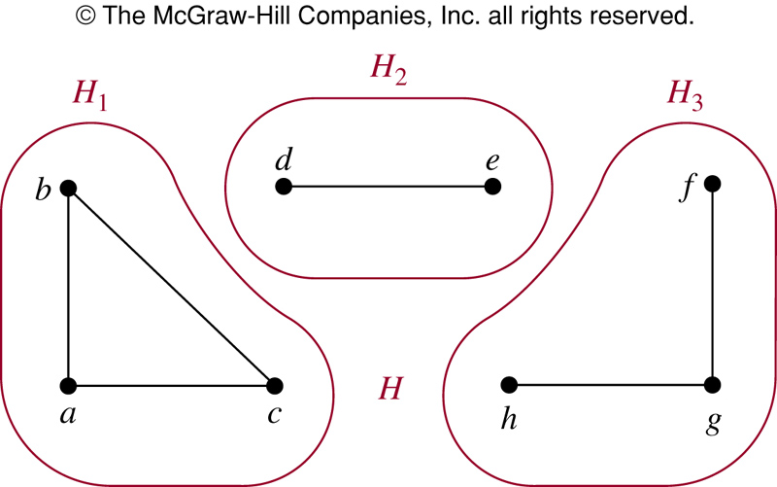
What are the weakly and strongly
Components of H below?
There is one weakly component: all the nodes
Strongly connected components:
- a
- e
the subgraph with vertices b,c,d
  (the triangle on the right)

Slide 12
Paths and Isomorphism
Paths are conserved under isomorphisms
Therefore, the length of simple circuits is a graph invariant
Conversely, we can try to establish isomorphism by tracing paths

Slide 13
Example
v₁
u₁
Same number of vertices
Same number of edges
v₂
v₃
u₂
u₃
Same number
of nodes with the same
degree
v₄
v₅
u₄
u₅
However, u has a simple
circuit of length 3 (actually
2 of them)
v₆
u₆
v has no simple
circuit of length 3

Slide 14
Establishing isomorphism
v₁
u₁
v₂
v₃
u₂
u₃
v₄
v₅
u₄
u₅
Same # vertices, # edges, and # of nodes with equal degree
They both have a simple circuit of length 3, of length 4, and of length 5
So PERHAPS there is an isomorphism.

Slide 15
Finding an isomorphism
Attempt to establish corresponding paths in both graphs that preserve edges/degree
Start from v₁. It could map to
  u₁, u₄, u₅ (because of degree)
We first try v₁ → u₁. (later u₄ and u₅)
Consider the neighbors of v₁, say v₂; it could map to
  any neighbor of u₁, i.e., u₃ or u₄
  u₄ does not match v₂ in degree
  so v₂ → u₃

Slide 16
Finding an isomorphism
Now consider the neighbors of v₂, let’s say v₄ (v₁ already visited). It could map to
  neighbors of u₃, i.e., u₁, u₂, or u₅
  u₁ is spoken for; u₂ doesn‘t match v₄ in degree
  So v₄ → u₅
Now consider the neighbors of v₄
  v₅ is the only one left
  it could map to neighbors of u₅, i.e., u₃ or u₂
  u₂ is the only one left and matching, so v₅ → u₂

Slide 17
Finding an isomorphism
We have only v₃ and u₄ left, which match in degree so the isomorphism is
  v₁ → u₁, v₂ → u₃, v₄ → u₅, v₅ → u₂, v₃ → u₄
The process could fail at some point, in which case we would backtrack to the previous choice point
If all choice points are exhausted, there is no isomorphism
This is an example of depth-first search

